Slide 1

Sales Behavior and Customer Data Project
dataset used

Slide 2


Questions I will answer:
  What are top 5 best selling products?
  What shipping methods are the most preferred?
  Do consumers pay lower than average price after applying discounts?
  Which regions have the highest sales?
  How are sales across different demographics?
  Which category shows the maximum sales?
  How are seasonal variation in sales?

Slide 3

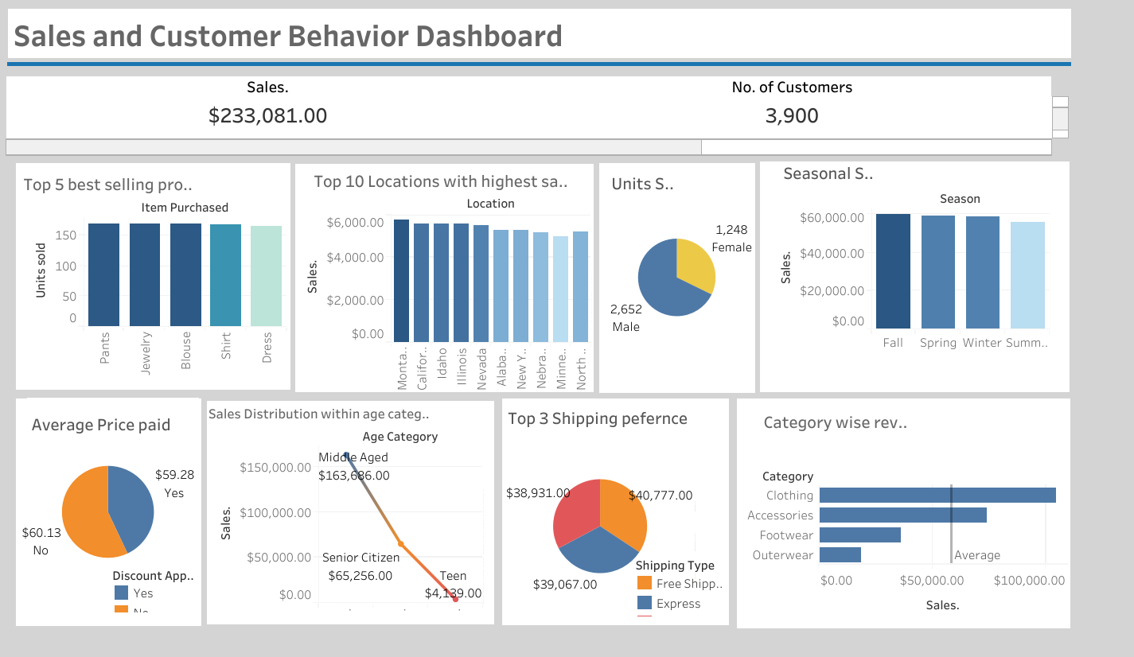
DASHBOARD
Visual representation of all the analysis done on the dataset
The visuals show the KPIs on the top segment.
The first graph shows the top 5 best selling products.
Followed by top 10 locations (based on the sales).
Then we see the seasonal variations in sales
On the bottom left corner we see a pie chart showing average price paid by customers with and without a discount code.
We then see the sales distribution across 3 different age groups.
Then there is an analysis done on the top 3 shipping method based on sales.
And finally we see category wise sales.

Slide 4
Insights and Strategic Solutions
We see the total sales, i.e, approximately 233k USD
Jewelry, pants, blouse, etc are the top 5 products, hence the company should bring more options and designs for the costumers to expect a growth in revenue
The company shall increase the numbers of outlets in Montana, California, Idaho to increase accessibility for a larger customer base
As for the demographics, majority of the customers belong to the middle aged segment and mostly are male. Teens are significantly less in percentage
Very slight seasonal variation is observed with maximum sales in spring. The company shall offer higher discounts during fall to gain more customers and give vouchers for future use.
The average price paid by customers after discounts is lower.
The 4 most sought after shipping methods are free, express and store pickup. The company shall collaborate and form more extensive delivery networks to offer express deliveries and as mentioned earlier, opening more stores will give higher flexibility for customers (for store pickup)
Clothing and accessories categories have performed better than average where as footwear and outwear lacked behind, falling below average, thus the company shall do customer surveys to see what the customers exactly want so that they offer what the customer wants.
Back to Agenda

